Slide 1

Bike dekho sales analyses

Slide 2
Objectives
To analyze factors influencing bike purchase decisions
To identify patterns and insights
To design an interactive dashboard
To support business decisions

Slide 3
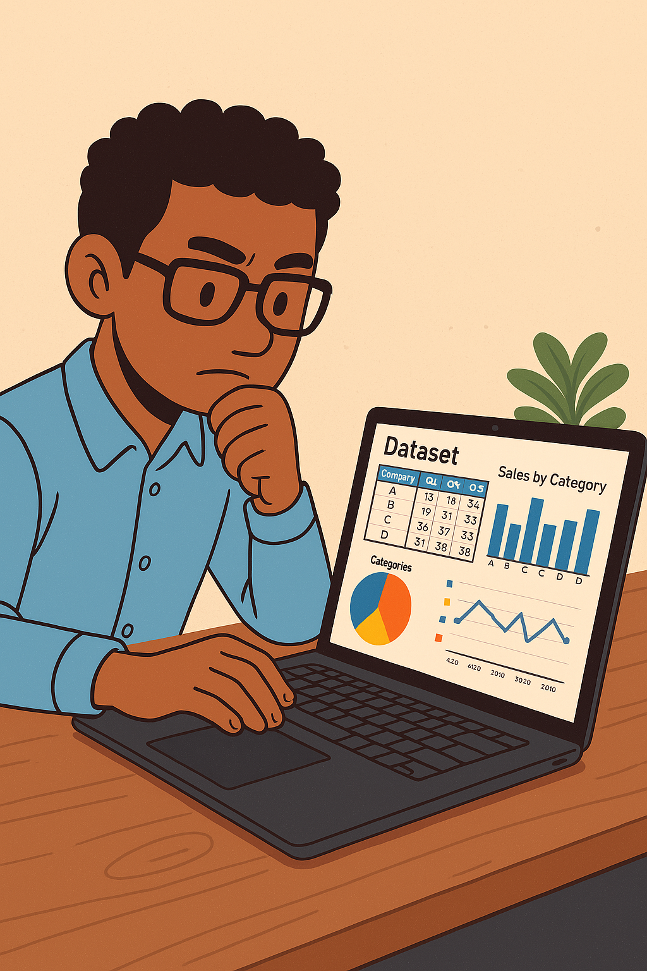
Data Overview
The dataset contains information on 1,000 individuals
There are attributes like- ID, gender, region, occupation, income, etc.
The dataset is balanced in terms of gender and includes a diverse mix of occupations and regions.

Slide 4
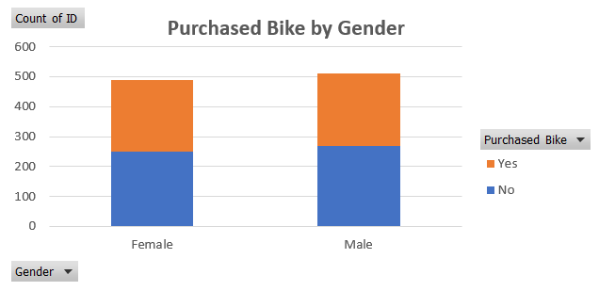
Excel insights
The dataset consists of 489 females and 511 males
Female Purchase Rate:
(239/489)*100 = 48.88 %
Male Purchase Rate:
(242/511)*100 = 47.35 %
Both genders show almost equal likelihood of purchasing a bike. The difference is less than 2%, meaning gender does not significantly influence the decision to purchase a bike in this dataset.
The number of people who didn’t buy a bike is:
250 females
269 males

Slide 5
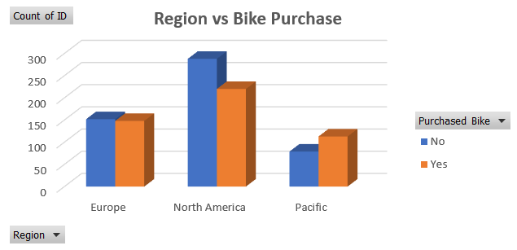
North America
Total Users: 508 (over half the dataset)
Bike Purchasers: 220
Non-purchasers: 288
Purchase Rate: (220÷508)×100≈43.3
Pacific
Total Users: 192
Bike Purchasers: 113
Non-purchasers: 79
Purchase Rate: (113÷192)×100≈58.9
Europe
Total Users: 300
Bike Purchasers: 148
Non-purchasers: 152
Purchase Rate: (148÷300)×100≈49.3

Slide 6
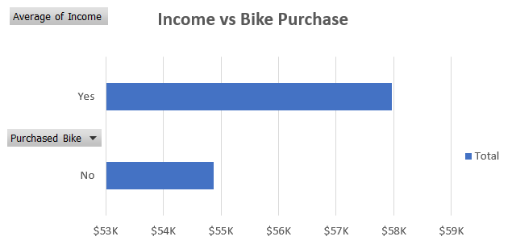
Individuals who purchased a bike have a higher average income by:
$57,962.58−$54,874.76= $3,087.82
Percentage Difference:
($3,087.82÷$54,874.76)×100≈ 5.63

Slide 7
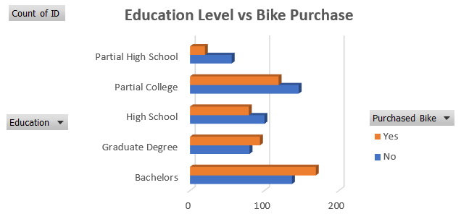
Bachelor’s Degree Holders
Highest number of bike purchases (169) among all education groups.
Purchase rate:
(169÷306)×100≈55.2
Graduate Degree Holders
Bike Purchasers: 94
Purchase rate:
(94÷174)×100≈54.0
High School Graduates & Partial College
High School Purchase Rate:
(79÷179)×100≈44.1
Partial College Purchase Rate:
(119÷265)×100≈44.9
Partial High School
Only 20 out of 76 purchased a bike
Purchase rate:
(20÷76)×100≈26.3

Slide 8
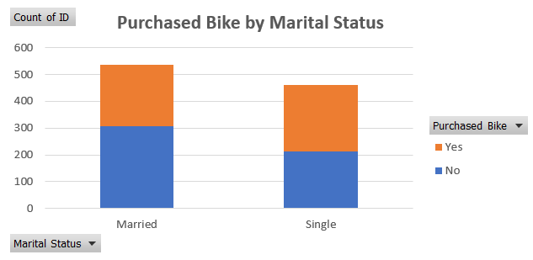
Married Individuals
Bike Purchasers: 231
Total Married Individuals: 538
Purchase Rate:
(231÷538)×100≈ 42.9
Single Individuals
Bike Purchasers: 250
Total Singles: 462
Purchase Rate:
(250÷462)×100≈ 54.1

Slide 9
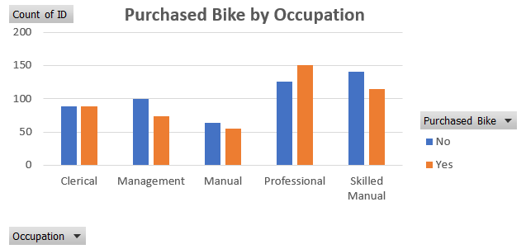
Professionals
Bike Purchasers: 150
Purchase Rate: (150 ÷ 276) × 100 ≈ 54.3%
Skilled Manual Workers
Bike Purchasers: 115
Total Skilled Manual: 255
Purchase Rate: (115 ÷ 255) × 100 ≈ 45.1%
Management
Bike Purchasers: 73
Total: 173
Purchase Rate: (73 ÷ 173) × 100 ≈ 42.2%
Clerical and Manual
Clerical Purchase Rate: (88 ÷ 177) × 100 ≈ 49.7%
Manual Purchase Rate: (55 ÷ 119) × 100 ≈ 46.2%

Slide 10
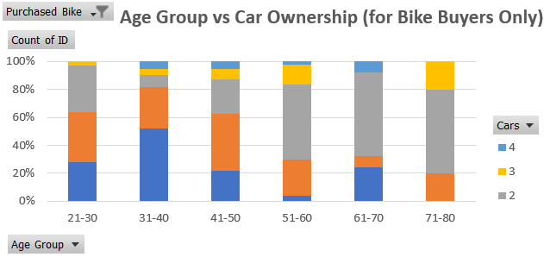
Young Buyers (21–30)
Majority of these buyers own 0–1 car (11 + 14 = 25 out of 39 ≈ 64%).
Very few (only 1) own 3 cars; none own 4 cars.
Prime Age Group (31–40)
This age group accounts for ~40% of all bike buyers (193 out of 481).
Interestingly, many of them own 0 or 1 car (101 + 57 = 158).
10 of them even own 4 cars yet still purchased a bike.
Middle-Aged Buyers (41–50)
Spread across all car ownership levels, with a noticeable peak at 2 cars (34) and 1 car (57).
Around ~33% own 2+ cars, still choosing to buy a bike.
Older Buyers (51–60)
A majority own 2+ cars (43 + 11 + 2 = 56) out of 80.
Senior Buyers (61–80)
Very low sample size (only 30 buyers total from 61–80 age group).
Still, 15 of the 25 in 61–70 group own 2 cars, and some even own 3.

Slide 11
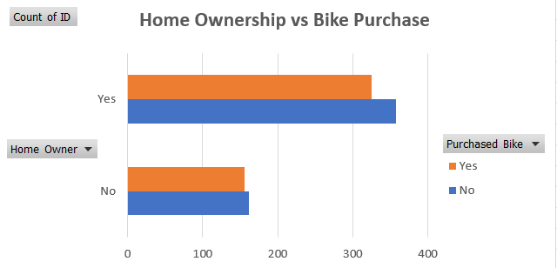
Home Owners:
Purchase Rate: (330 ÷ 700) × 100 = 47.14 %
Non-Purchase Rate = 52.86%
Non-Home Owners:
Purchase Rate: (150 ÷ 310) × 100 = 48.39 %
Non-Purchase Rate = 51.61%

Slide 12
Recommendations to increase bike sales
Target Singles – Higher purchase rate (54%); focus on independence & mobility.
Focus on Graduates & Professionals – Strong interest in premium bikes.
Expand in Pacific Region – Highest bike purchase rate (~59%).
Promote to High-Income Groups – More likely to buy; offer EMI plans.
Highlight Bikes as 2nd Vehicles – Many buyers already own 2+ cars.
Leverage Homeowners – Form majority of bike buyers.
Custom Messaging by Occupation – Durability for workers, efficiency for managers.
Use Data Segmentation – Combine traits (e.g., Single + Graduate + $55K+) for targeted campaigns.

Slide 13
Thank you
HIMANSHU
Role: Data Analyst Intern
hiimanshuu0406@gmail.com

